Slide 1
Service Discovery 101

Slide 2
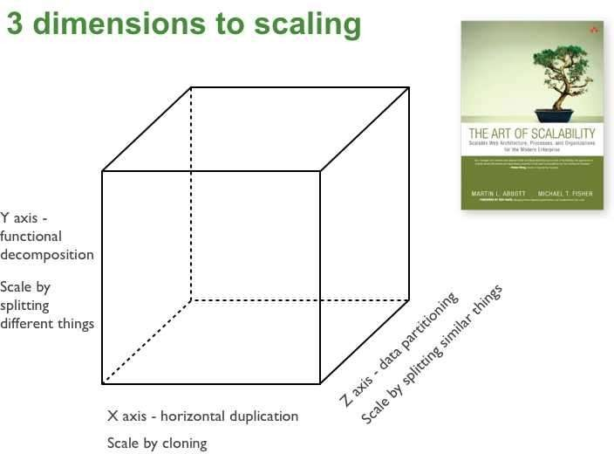
Scale Cube

Slide 3
Microservice Architecture
scale via functional decomposition
mediate client communication
design for eventual consistency
expect services to come and go (this talk!)
automate deployment
expose runtime statistics and metrics

Slide 4
Expect services to come and go!
auto-scaling, i.e. set of service instances may change dynamically
server failures, i.e. service instances have dynamically assigned network locations
upgrades/configuration changes

Slide 5
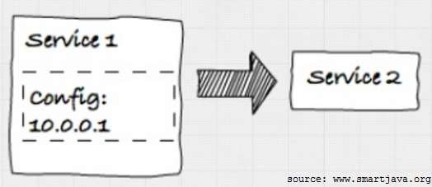
Hardcoded IP
doesn‘t scale
not resilient to failures
config locality

Slide 6
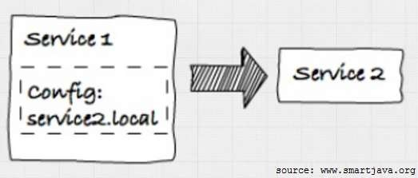
DNS
doesn‘t scale
not resilient to failures
DNS server required

Slide 7
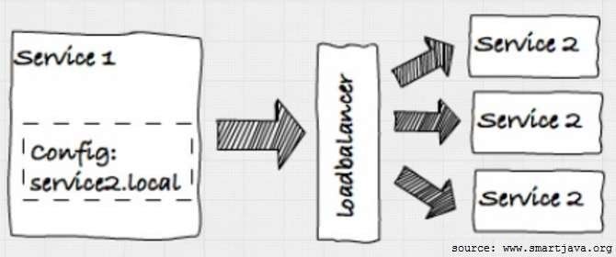
DNS with Loadbalancer
scale out
failure detection possible (loadbalancer support?)
loadbalancer new single point of failure
dynamic load balancer reconfiguration not trivial

Slide 8
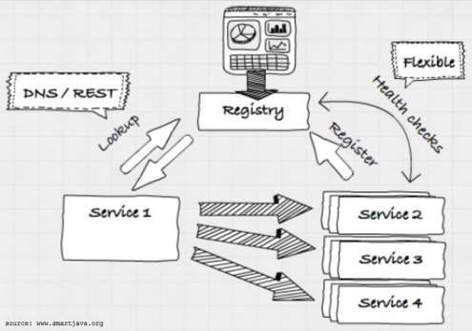
Service Registry
scale out (fully automatable)
failure detection
distributed key-value store for configuration

Slide 9
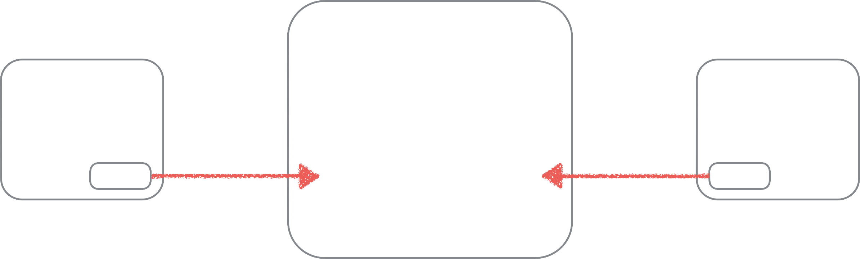
10,000 foot view
service registry
upstream service
downstream service
registers
discovers

Slide 10





1,500 foot view
Netflix Eureka
service registry
ZooKeeper
SmartStack: Nerve, Synapse
SkyDNS

Slide 11
1,000 foot view
Registration: service-initiated sidekick
upstream service
-
-

Slide 12
500 foot view
Discovery: API DNS
LB
downstream service
-
-
-

Slide 13
Consul
+
Docker
+
Registrator
=
Rapid Prototyping

Slide 14







server
bootstrap, ui, DNS
server
ping-client
Registrator
pong-server
node-01
node-02
server
Registrator pong-server
node-03

Slide 15
Service Discovery Patterns
client-side vs server-side discovery
self-registration vs third-party registration
Check out
https://www.nginx.com/blog/service-discovery-in- a-microservices-architecture/
http://microservices.io/

Slide 16
Summary
A Service Registry is necessary for robust systems, as
services may be started and stopped in any order,
servers may fail/be restarted,
configuration may be changed!
Recommendation: Consul by HashiCorp

